Slide 1


Blockchain Technologies
Transforming Industries with Innovation
By Khushi Shekhawat
23fs20mca00031

Slide 2

Introduction
Blockchain is a decentralized, distributed digital ledger that records transactions securely and immutably
Decentralization
Transparency
Key
features
Security and Immutability
Automation through Smart Contracts

Slide 3
Why we use Blockchain Technology -
Enhanced Security
1
Cryptographic methods ensure data integrity
Transparency
2
All transactions are visible on the public ledger
Immutability
3
Once data is recorded, it cannot be altered
Decentralization
4
No single point of failure
Cost Efficiency
5
Reduces need for intermediaries

Slide 4





Current Uses of Blockchain Technology
Supply Chain Management | Finance | Gaming and NFTs | Smart Cities | Healthcare
Tracking goods in real-time with blockchain ensures transparency. | Cryptocurrencies like Bitcoin and Ethereum have revolutionized digital transactions (DeFi) | Blockchain enables ownership of digital assets, including in-game items. | Blockchain automates systems for better governance. | Blockchain secures patient data management and improves interoperability.

Slide 5
Immutable vote recording
Decentralized Voting System
Real-time vote tallying
Data In 2021
A blockchain-based solution to conduct secure, transparent elections
Voter anonymity
04

Slide 6


Comparison with Traditional Voting Systems
Feature | Traditional Voting | Blockchain Voting
Security | Susceptible to fraud | Highly secure
Transparency | Limited | Fully transparent
Cost | High | Lower
Accessibility | Physical presence needed | Remote voting enabled

Slide 7
Understanding decentralization, ledgers, and cryptography | Writing and deploying smart contracts | Managing and querying relational databases for project backend | Creating a user-friendly interface for voters | A personal Ethereum blockchain for testing | Handling transactions and voter authentication.
My Learning Journey
6
5
4
MetaMask Wallet
3
2
Ganache
1
Frontend Development
SQL
Solidity Programming
Basics of Blockchain

Slide 8
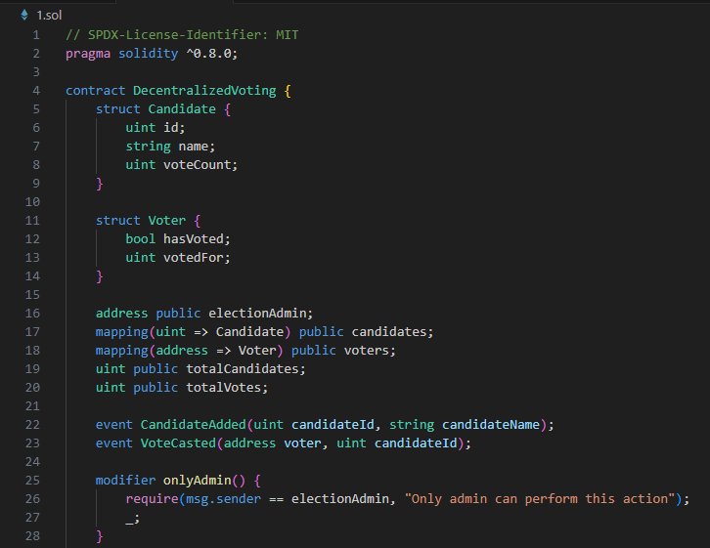
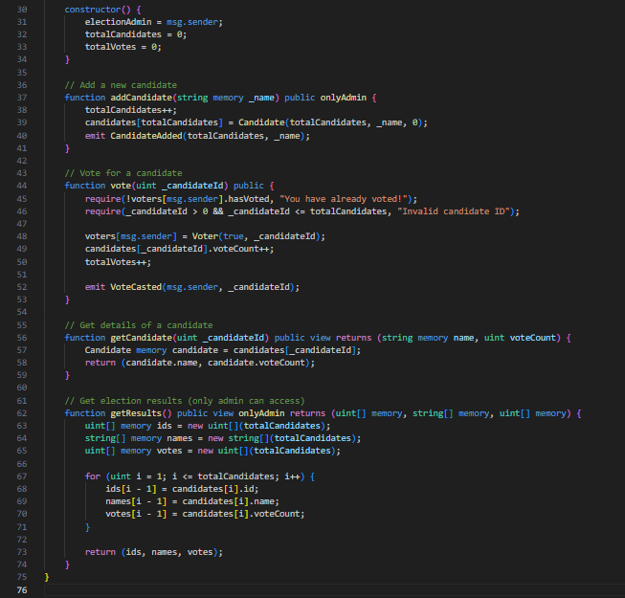
Workings...
Solidity Lang...

Slide 9
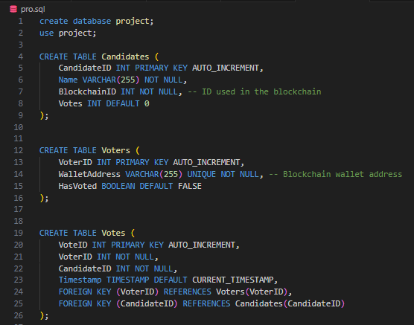
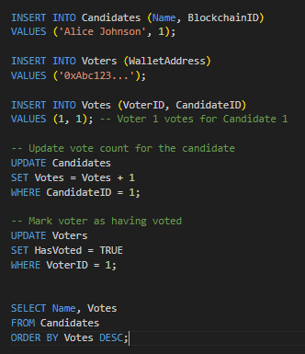
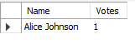
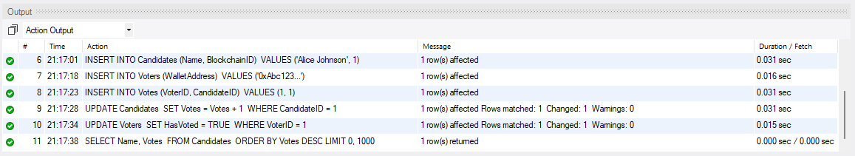
SQL
Database

Slide 10
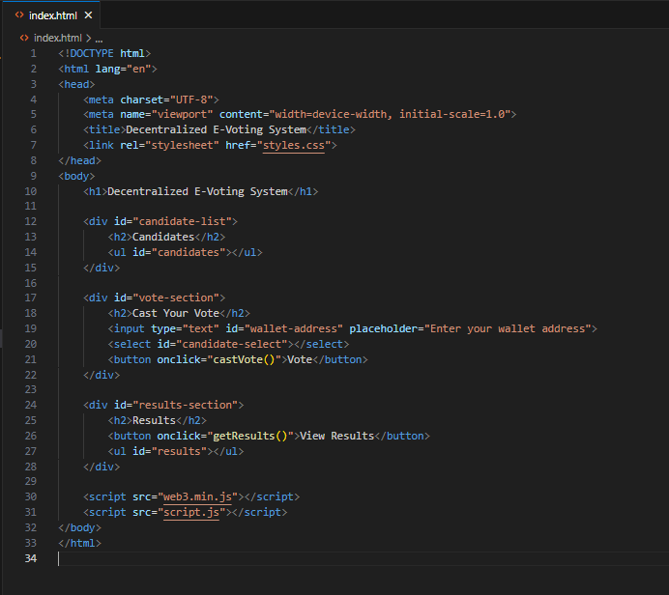
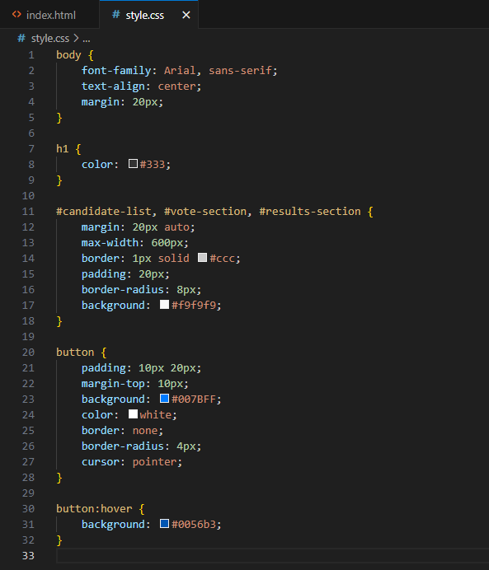
Frontend - 1

Slide 11
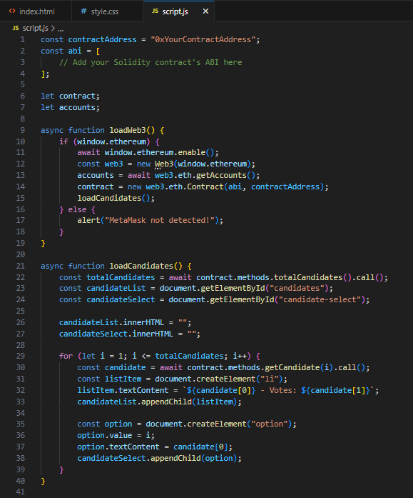
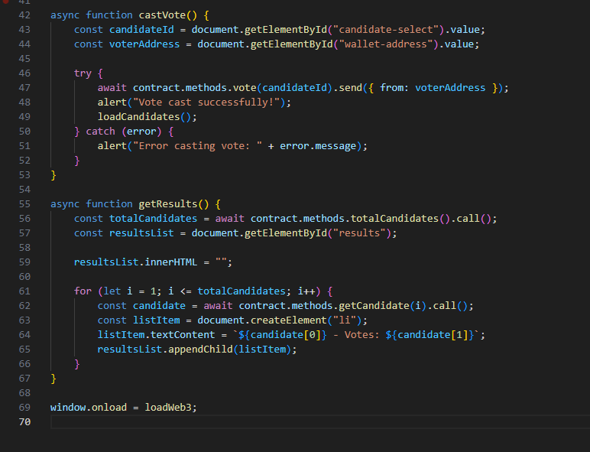
Frontend - 2

Slide 12
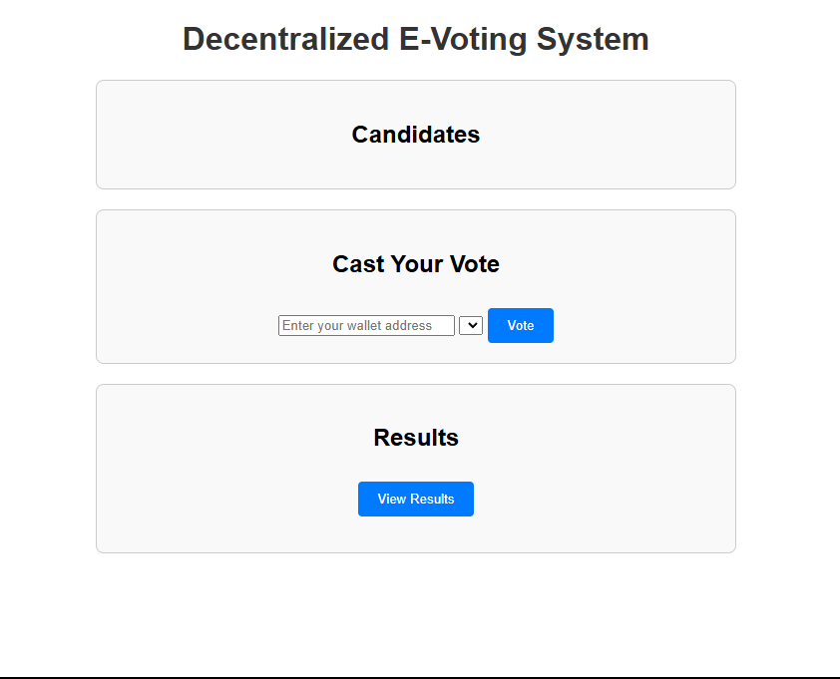
Project Outcome

Slide 13
Conclusion
Summary
My Project’s Impact
Looking Ahead
Blockchain technology is revolutionizing industries by offering unmatched security, transparency, and efficiency. From finance to healthcare and governance, its real-world applications are solving complex challenges and creating new opportunities
The decentralized e-voting system highlights the potential of blockchain in transforming democratic processes. By ensuring secure and transparent elections, this project demonstrates how blockchain can address long-standing issues in traditional voting systems.
My journey through blockchain basics, Solidity, SQL, frontend development, and tools like Ganache and MetaMask reflects the vast potential of this field. With further innovation, blockchain is poised to become a cornerstone of digital transformation globally

